Slide 1


NAME : SHRAVAN. H J REG NO : U15JP21S0215 SUBJECT : CLOUD COMPUTING
SEMINAR ON
VIRTUALIZATION

Slide 2
Contents
What is Virtualization?
Types of Virtualization.
Server Virtualization.
Storage Virtualization.
Network Virtualization.
Desktop Virtualization.
Application Virtualization.
Thank You.

Slide 3
What is Virtualization?
Virtualization in cloud computing refers to the creation of virtual versions of computing resources, such as servers, storage, and networks. This technology allows multiple virtual instances or machines to run on a single physical server, enabling more efficient use of resources and improving scalability and flexibility.

Slide 4
Types of Virtualization
Server Virtualization
Storage Virtualization
Network Virtualization
Desktop Virtualization (VDI - Virtual Desktop Infrastructure)
Application Virtualization

Slide 5
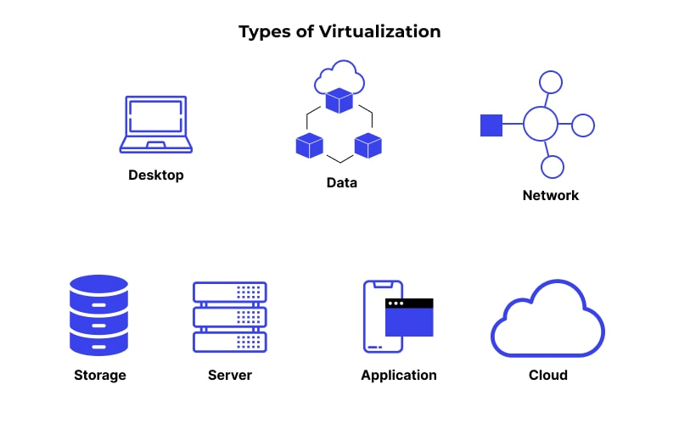
Types of Virtualization

Slide 6
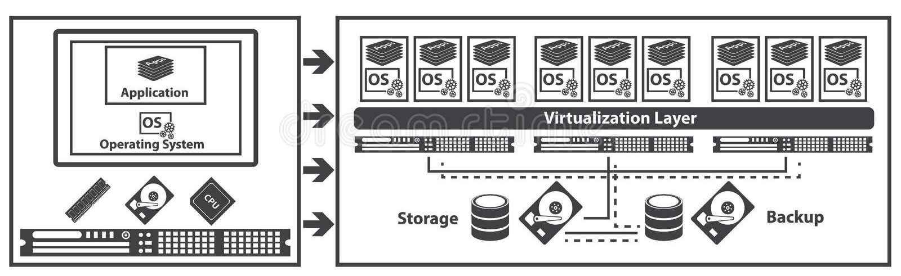
Server Virtualization
Definition: Server virtualization involves dividing a physical server into multiple virtual servers, each capable of running its own operating system and applications.
Benefits: Improved resource utilization, flexibility, and scalability. Multiple virtual servers can run on a single physical machine, optimizing hardware usage.

Slide 7
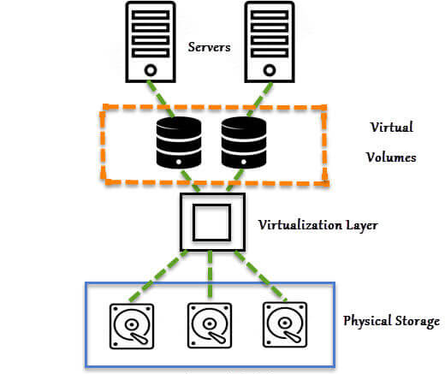
Storage Virtualization
Definition: Storage virtualization abstracts physical storage resources and presents them as a unified storage pool. It allows for efficient management and allocation of storage resources.
Benefits: Simplified storage management, improved data protection, and flexibility in allocating storage to applications and virtual machines.

Slide 8
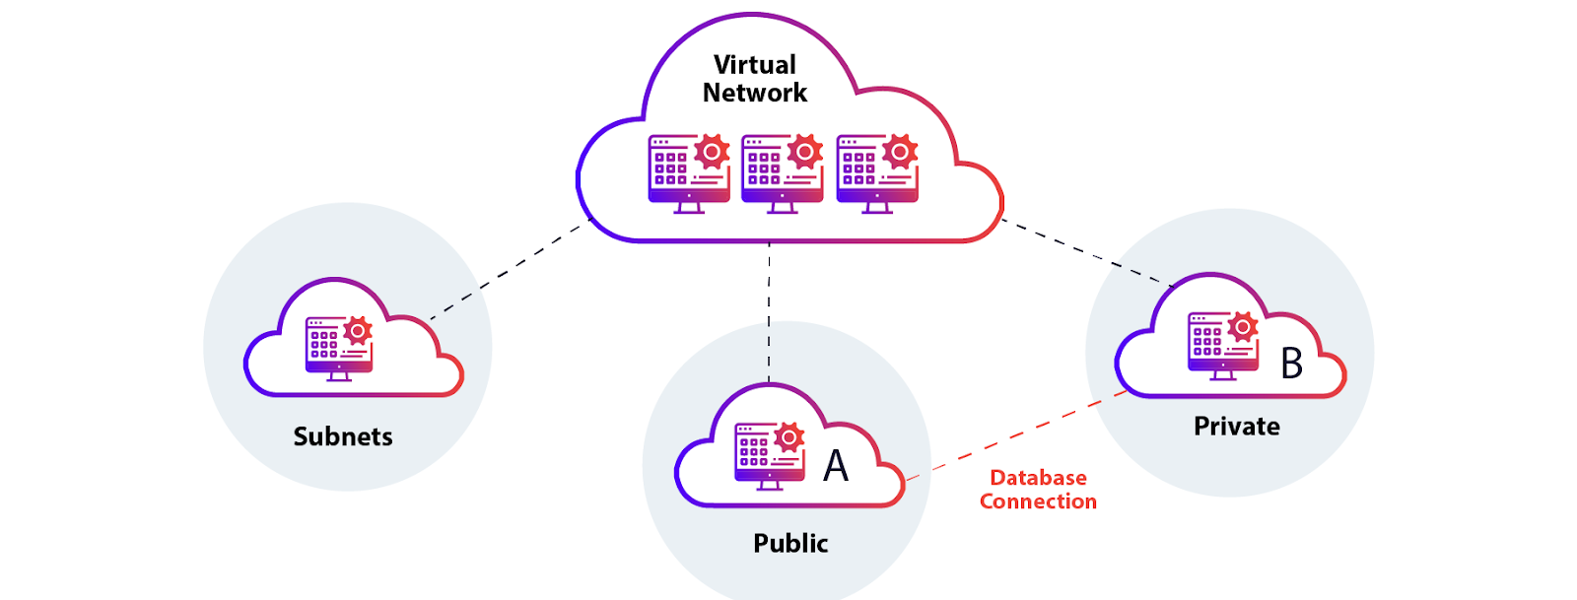
Network Virtualization
Definition: Network virtualization involves creating virtual networks on top of physical networks. It allows for the abstraction of network resources and enables the creation of isolated, customizable virtual networks.
Benefits: Enhanced network flexibility, isolation, and customization. It simplifies network management in a cloud environment.

Slide 9
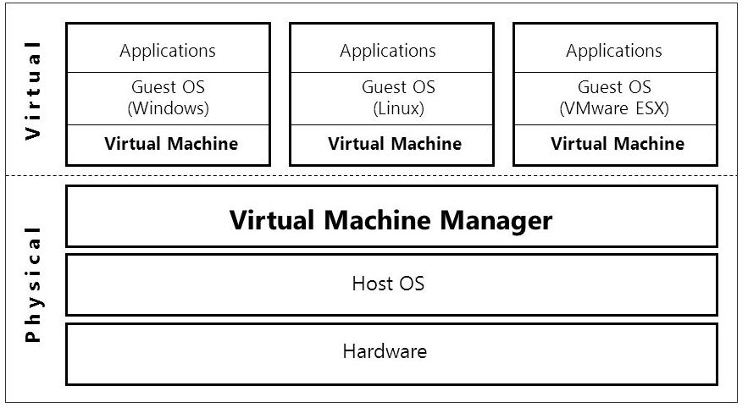
Desktop Virtualization(VDI : Virtual Desktop Infrastructure)
Definition: Desktop virtualization involves hosting desktop environments on a centralized server and delivering them to end-user devices over a network.
Benefits: Centralized management of desktop environments, improved security, and flexibility for users to access their desktops from various devices.

Slide 10
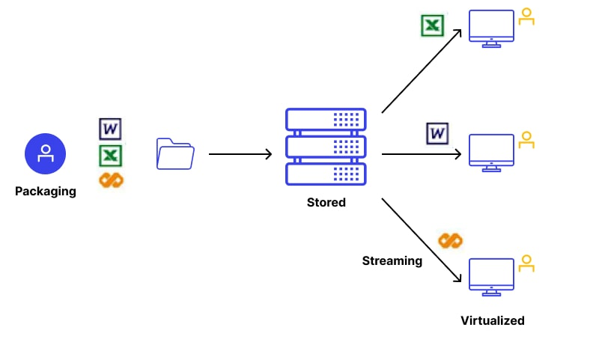
Application Virtualization
Definition: Application virtualization encapsulates applications and their dependencies into isolated packages, allowing them to run on various systems without traditional installation.
Benefits: Simplified application deployment, improved compatibility, and efficient use of system resources.

Slide 11

Thank You

